Slide 1
Exception handling
In C#

Slide 2
try - catch - finally
That’s what it about

Slide 3
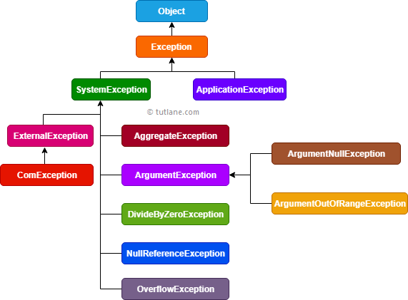
What it Contains from

Slide 4
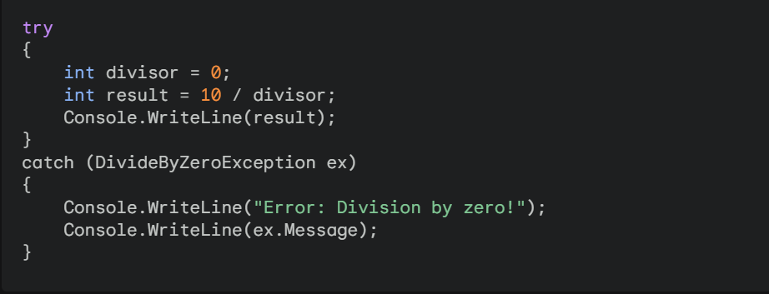
Basic try – catch Block
Here the code you want to try
And here the code to handle the exception

Slide 5
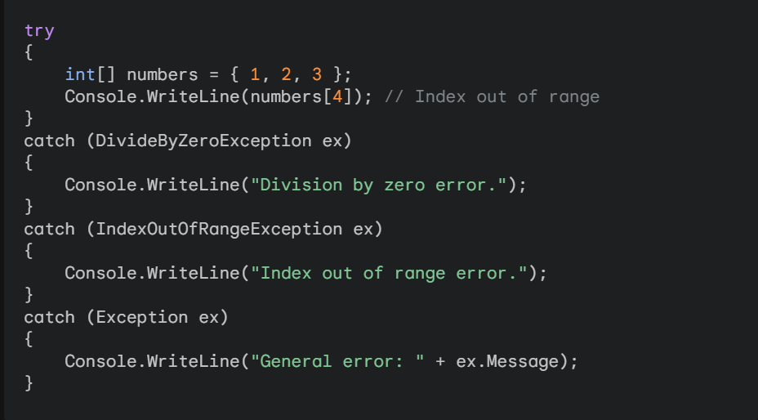
Multiple catch Block
You can’t use catch (Exception ex) In the first catch because it’ll cancel all the catch blocks after it .
We can say that (Exception) is the Primary class for all Exceptions.
But with some Conditions :-

Slide 6
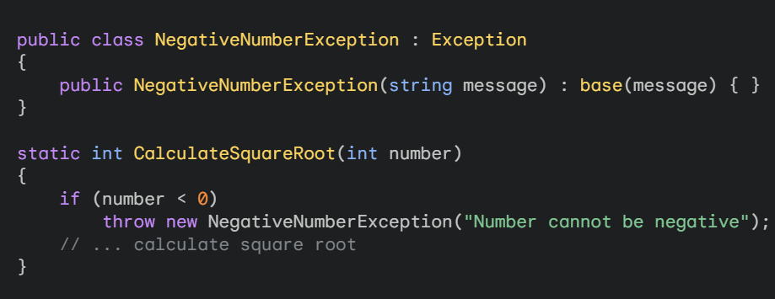
Custom Exception Block
You can create your own Exceptions.
All you have to do is to make the same idea of the Base & Derived Class .
You can inherits from the Exception class like I mentioned before it’s the Primary class.

Slide 7
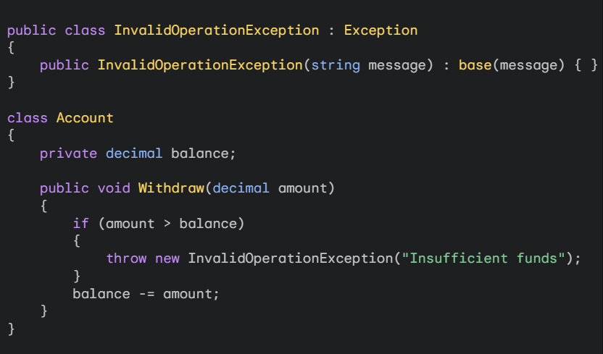
Example For custom exceptions
inherits from the Exception class
Condition for your Exception
The way to call the method must begin with throw new

Slide 8
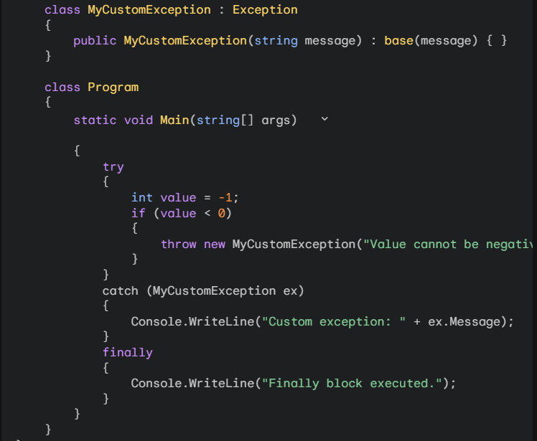
And there is the finally Block
It’s to executes last in any condition even if the Exception didn’t happened.
Like in the example if the value was negative or not it’ll print Finally block executed.
But at the end finally block it’s an optional block not required actually.

Slide 9
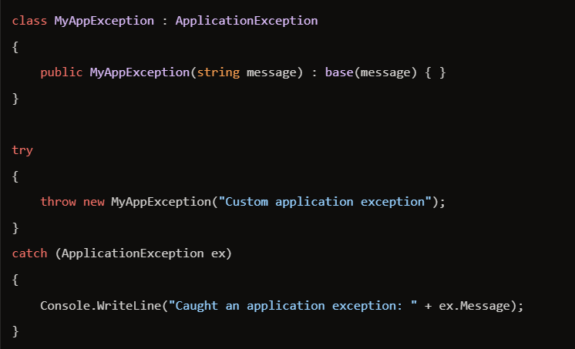
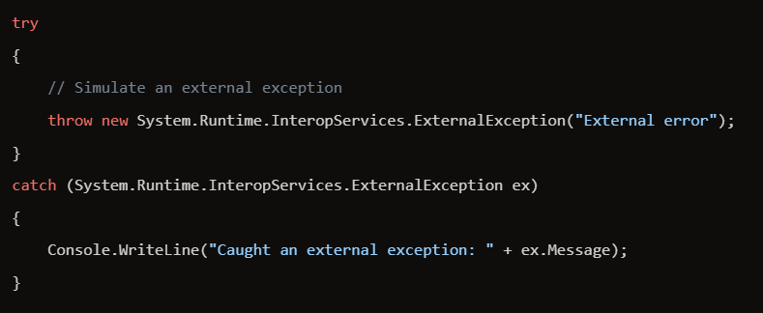
Some examples for the types of Exceptions
Application Exception
External Exception
Base class for user-defined exceptions but actually not important or not recommended to use
Exception type for external error conditions originating from outside the runtime control.

Slide 10
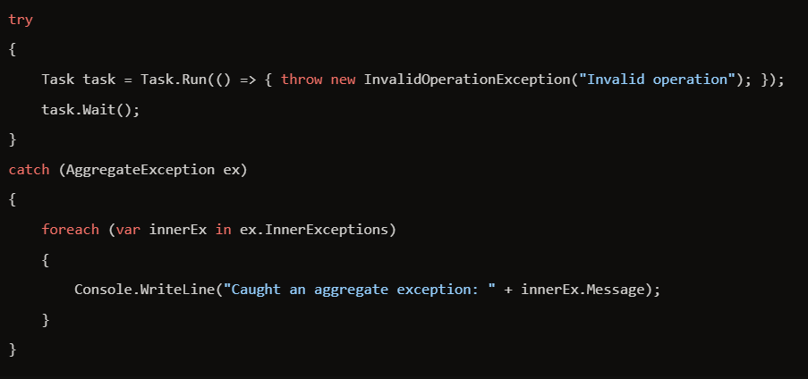
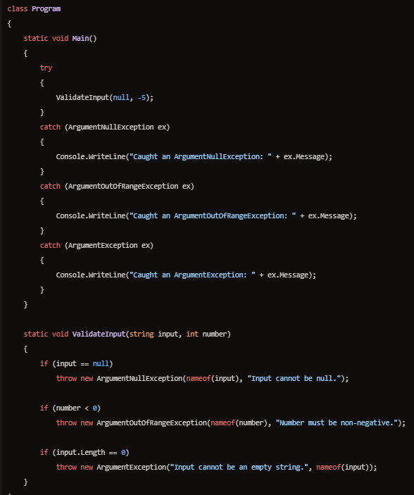
Some examples for the types of Exceptions
Aggregate Exception
Argument Exception
Argument Exception include Argument Null Exception and Argument out of Range Exception
But it obvious from there names what can they do
First one is Thrown when a null reference is passed to a method
Second one is Thrown when an argument’s value falls outside the expected range
This type Represents one or more errors that occur during application execution.
And it a little advanced for now

Slide 11
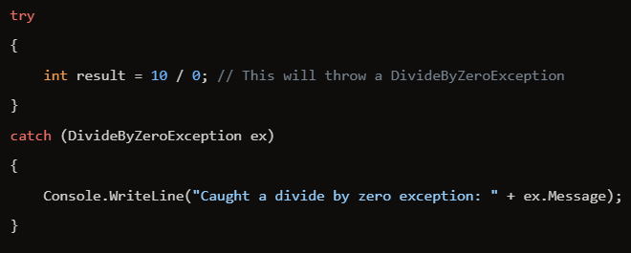
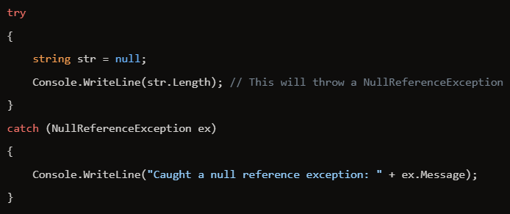
Some examples for the types of Exceptions
Divide By Zero Exception
Null Reference Exception
Thrown when attempting to divide an integral or decimal value by zero.
Thrown when attempting to dereference a null object reference.

Slide 12
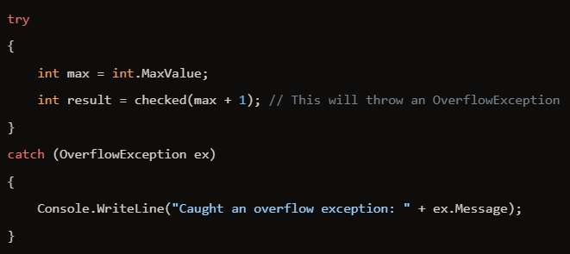
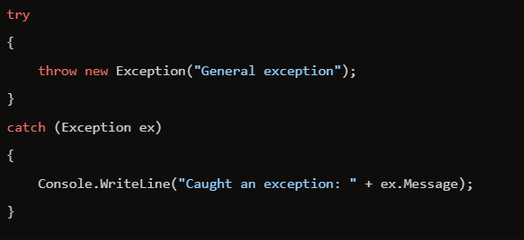
Some examples for the types of Exceptions
Overflow Exception
Exception Base Class
Thrown when attempting to divide an integral or decimal value by zero.
And the last thing is the Base class, You can use it and it’ll catch any system Exception.

Slide 13



Slide 14
Thank You
Hope you like The Personation

